Slide 1
Apache Spark Architecture

Slide 2
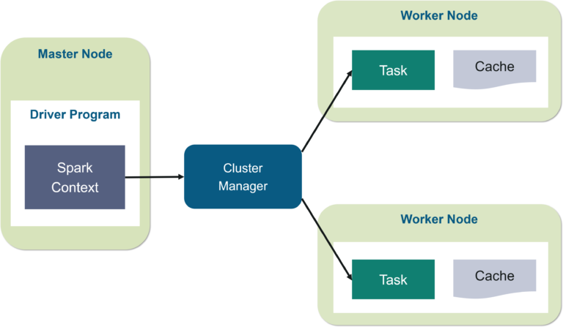
In your master node, you have the driver program, which drives your application. The code you are writing behaves as a driver program or if you are using the interactive shell, the shell acts as the driver program.

Slide 3
Inside the driver program, the first thing you do is, you create a Spark Context. Assume that the Spark context is a gateway to all the Spark functionalities. It is similar to your database connection. Any command you execute in your database goes through the database connection. Likewise, anything you do on Spark goes through Spark context.
Now, this Spark context works with the cluster manager to manage various jobs. The driver program & Spark context takes care of the job execution within the cluster. A job is split into multiple tasks which are distributed over the worker node. Anytime an RDD is created in Spark context, it can be distributed across various nodes and can be cached there.

Slide 4
Worker nodes are the slave nodes whose job is to basically execute the tasks. These tasks are then executed on the partitioned RDDs in the worker node and hence returns back the result to the Spark Context.
Spark Context takes the job, breaks the job in tasks and distribute them to the worker nodes. These tasks work on the partitioned RDD, perform operations, collect the results and return to the main Spark Context.
If you increase the number of workers, then you can divide jobs into more partitions and execute them parallelly over multiple systems. It will be a lot faster.
With the increase in the number of workers, memory size will also increase & you can cache the jobs to execute it faster.

